Slide 1
Introduction to Classification

Slide 2
Introduction
In Machine Learning, classification is a supervised learning approach, which can be thought of as a means of categorizing or "classifying" some unknown items into a discrete set of "classes."
The target attribute in classification is a categorical variable with discrete values.
So, how does classification and classifiers work?
Let’s explain this with an example.

Slide 3
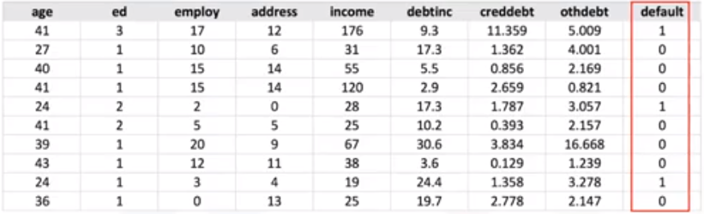
Binary Classification– Ex: Loan Default prediction
Binary Classification
Suppose a bank is concerned about the potential for loans not to be repaid.
If previous loan default data can be used to predict which customers are likely to have problems repaying loans, these "bad risk" customers can either have their loan application declined or offered alternative products.
The goal of a loan default predictor is to use existing loan default data, which is information about the customers (such as age, income, education, etc.), to build a classifier, pass a new customer or potential future defaulter to the model, and then label it (i.e. the data points) as "Defaulter" or "Not Defaulter", or for example, 0 or 1.
Categorical variable
?

Slide 4
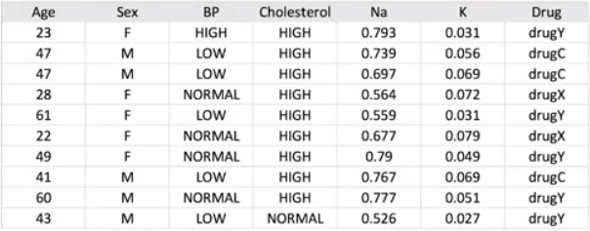
Multi-Class Classification-- Ex: Drug Prediction
Imagine that you collected data about a set of patients, all of whom suffered from the same illness.
During their course of treatment, each patient responded to one of three medications.
You can use this labelled dataset, with a classification algorithm, to build a classification model.
Then you can use it to find out which drug might be appropriate for a future patient with the same illness.
As you can see, it is a sample of multi-class classification.
Multi-class Classification
Categorical variable
?

Slide 5
Classification Use cases
Classification has different business use cases as well, for example:
To predict the category to which a customer belongs;
For Churn detection, where we predict whether a customer switches to another provider or brand
To predict whether or not a customer responds to a particular advertising campaign.

Slide 6
Classification Applications
Data classification has several applications in a wide variety of industries.
Essentially, many problems can be expressed as associations between feature and target variables, especially when labeled data is available.
This provides a broad range of applicability for classification.
For example, classification can be used for:
Email filtering,
Speech recognition,
Handwriting recognition,
Bio-metric identification,
Document classification, and much more.

Slide 7
Classification Algorithms
Here we have the types of classification algorithms in machine learning:
They include:
Decision Trees,
Naïve Bayes,
Linear Discriminant Analysis,
K-nearest neighbor,
Logistic regression,
Neural Networks, and
Support Vector Machines.

Slide 8

Please contact
Foundation for Innovation and Collaborative
Education
mentor@fice.in
www.fice.in
Please contact
Foundation for Innovation and Collaborative
Education
info@fice.in
mentor@fice.in
Notes:
Here are the lessons we are going to learn today.

